Slide 1


Term Deposit Prediction
A Data-Driven Approach for Al-Vive Banking
This presentation outlines a machine learning solution that enables targeted marketing for term deposit subscriptions, significantly reducing customer acquisition costs while increasing success rates. We'll explore key customer insights, model development strategy, and actionable recommendations.
By Khee Ern

Slide 2

About Me
Wong Khee Ern
"A ship is safe in harbor, but that's not what ships are for.“
My journey so far…
Graduated in 2016 from NTU with:
Degree in Engineering Science (EEE)
Masters in Technology
Professional Experience:
2017: Electrical Engineer at Keppel
2018: Intrapreneur at Keppel
2019: Project Manager at Synapxe
2023: Algorithmic Trader at Grasshopper
2025: Budding ML Engineer (AIAP Applicant)
When I am not coding…
I'm an enthusiastic golfer, avid travel planner, home automation hobbyist, and beginner cook.
Funny Story: Got chased by elephants in Khao Yai, Thailand. If I can survive charging elephants, no other problems are too big!
Why ML?
I'm passionate about solving business problems through technology and data-driven insights. ML represents the perfect intersection of systematic problem-solving, strategic thinking, and hands-on engineering.

Slide 3
EDA - Methodology
I adopted a systematic and iterative approach to analyze the data for subsequent model performance improvements
Initial dataset exploration
Data overview: Explore shape, features, target variable and missing values
Techniques employed:
Mean, std dev, percentile etc.
Frequency distribution, cardinality
Missing values analysis
Outlier detection / visualization
Thorough analysis for
first model run
Univariate feature analysis and target correlation through statistics, visualizations and effect size assessment
Techniques employed:
Numerical features: Mann-Whitney U test, Cohen's D for statistical significance and effect size
Crosstab, Chi-square, Cramer's V for categorical variables
Data deep dive to improve model performance
Bivariate/multivariate analysis and target correlation to detect multicollinearity and gather insights for feature engineering
Techniques employed:
3D heatmaps for correlation
Feature engineering with domain knowledge
Feature importances

Slide 4
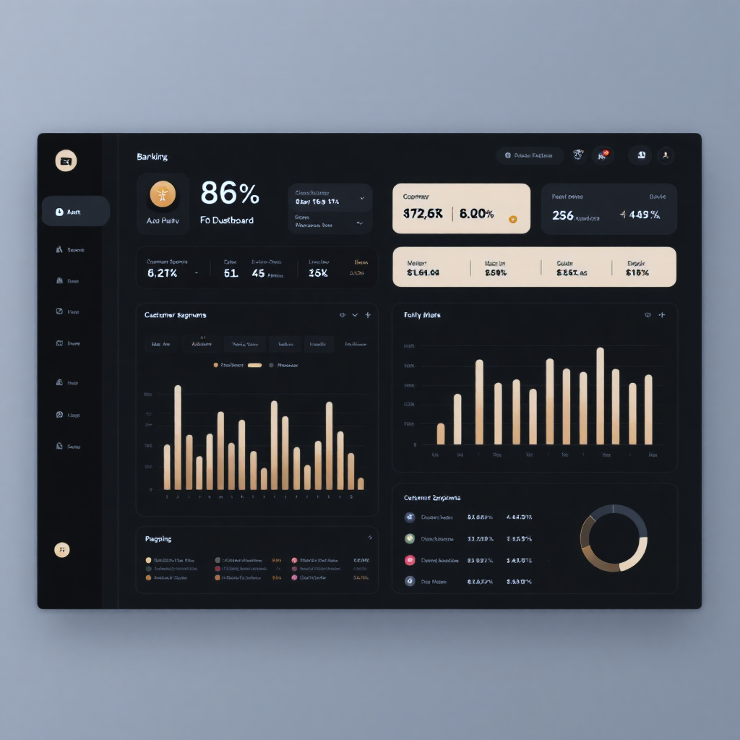




EDA – Key Data Insights
Data Challenges
Large class imbalance (only 10% subscribers)
Missing values in personal and housing loan categories
Highly imbalanced credit default data
Unknown values in multiple features
Temporal patterns for client ID
Pipeline design solutions
Implemented F2 scoring with recall emphasis
Used algorithms with built-in class imbalance handling
Stratified train-test split
Created binary features for missing financial data
Preserved unknown values in categorical features
Drop Client ID to preserve model integrity over predictive power improvement

Slide 5


EDA – Business Insights and data improvements
Actionable Business Intelligence Today, Enhanced Insights Tomorrow
Business Insights
High class imbalance signifies low campaign efficiency, indicating need to understand why conversion rates are historically low.
Prioritize gathering financial and credit history as they are likely to be significant predictors of subscription behavior.
Reduce resources on multiple calls and keep hot leads hot with quick follow-up.
Marketing needs active follow-up lists and should continue nurturing even failed conversions in previous campaigns
Campaign strategy should target younger and older clients while investigating why middle-aged customers have low subscription rates
Enhanced Data sources
Quick wins
Fill gaps in financial data through internal systems integration or credit agencies.
Campaign History data
Previous campaign outcome, Contact day and time
Macroeconomic data
Interest rates, treasury bills, inflation data
Comprehensive enhancements
Temporal features
Bonus seasons, holidays, campaign duration
Customer profiling
Account tenure, lifetime value, spending habits, multi-channel engagements
1
2
3
4
5

Slide 6
ML Pipeline Architecture
The pipeline was designed with modularity and reproducibility as key principles, enabling rapid iteration while maintaining good code quality standards.
Core capabilities
Configuration-driven architecture for rapid experimentation
Automated feature engineering with intelligent preprocessing
Nested cross-validation for model generalization evaluation
Multi-algorithm support including ensemble methods
Production Features
Comprehensive logging and monitoring
Automated threshold optimization
Visualization suite for stakeholder reporting
Single file orchestrator for simplified deployment
Technical Implementation
Setup: YAML-based configuration management, directory management, logging system
Data Preparation: SQLite database connection, data cleaning, train/test split
Model Development: Automatic feature type detection with scikit-learn pipelines, configurable algorithm selection and hyper parameter grid
Model Training:, Nested cross-validation with GridSearchCV to train models on best hyper parameters
Evaluation: F2 Score optimization (recall emphasis), MCC, and PR-AUC curves, CV vs test set comparison, feature importances
Output: Serialized models, evaluation reports, and performance visualizations

Slide 7
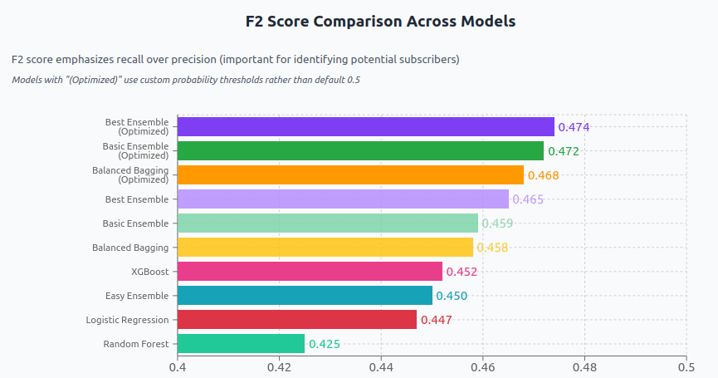
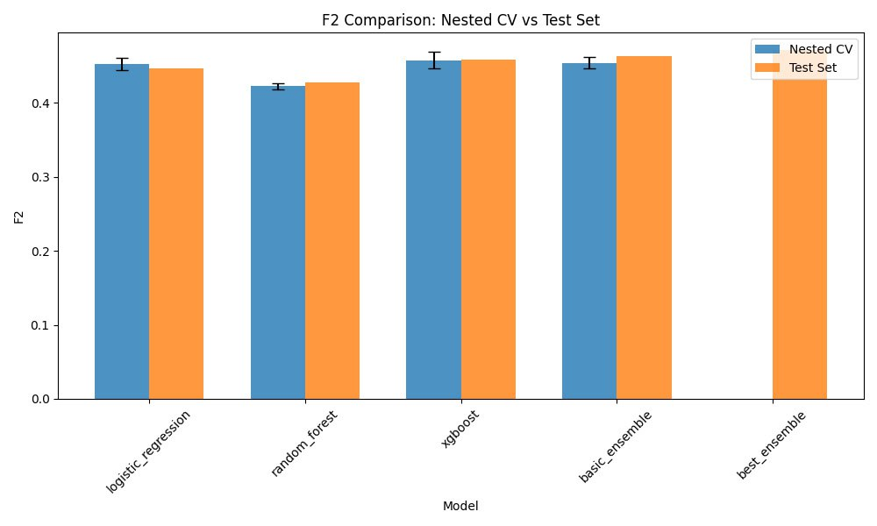
Model Prediction Performance
Best ensemble (optimized)
High Recall 0.82
Identifies 4 out of 5 potential term deposit subscribers for marketing team to contact
Lower Precision 0.18
Trade-off: Only 1 out of 5 chance that identified potential customers will convert to subscribers
Graph shows models are generalizing well from cross-validation to the test set, with small and acceptable variance.

Slide 8
Future Model Improvements
Enhanced Data Sources
Fill gaps in financial data through internal systems integration or credit agencies. Incorporate interest rates, treasury bills, bonus seasons, previous campaign outcomes, and customer spending habits for more precise targeting.
Better feature engineering
More systematic, iterative approach to improve model predictive performance through feature engineering and selection
Log to keep track of engineered features
Use permutation importance and SHAP to understand why and how
Make keep/discard decision based on performance + interpretability with backward selection
More Rigorous Coding
Improve on coding best practices to ensure code readability, easier maintenance and upgrade, and improved performance.
Write preprocessing validation tests to ensure data quality and check for leakages
Business Metric Optimization
Shift from statistical to profit-based metrics, optimizing for term deposit value, campaign costs, and lifetime customer value rather than pure classification performance.

